Slide 1
DLT On The Go!
Donor Registration Anywhere

Slide 2
What is Donate Life Texas?
Donate Life Texas (DLT) - is the official state organ, eye & tissue donor registry.
Created in 2006 as part of Donate Life America registry network
A database of Texas residents who voluntarily give legal authorization to be organ, eye and tissue donors after death
Led by the 3 Texas OPOs in partnership with 11 eye & tissue banks serving Texas

Slide 3
How To Register
There are several ways to join the Donate Life Texas Donor Registry:
Go online to www.DonateLifeTexas.org to register in 60 seconds or less!
OR, complete and mail or fax a paper application
OR, say “Yes” when asked if you would like to register as an organ donor when applying for or renewing your Texas driver license or ID card.
OR, say “Yes” when applying for or renewing your Texas vehicle registration
OR, using the Med ID tab in the iPhone Health App
OR, using the DLT Mobile App at an event
Whichever method is uses to join the Donate Life Texas registry, duplication is never a problem. Should a person register more than once, the system will combine duplicate records based on driver license number or other personal identifying information.
And, people can change or update their registration at any time on the DLT website.
The most recent record reflects their registration status.

Slide 4
DLT – There’s an App for That!
The DLT Scan App will make registering people at events as easy as Scan. Click. Done!
The App scans the digital bar code on the back of Texas driver licenses and ID card to populate a registration form. The card holder then reviews the information then clicks the electronic signature to send their information securely to the DLT Registry.
The App will be available to authorized staff and representatives of DLT Organizations who have been granted DLT Registry Admin Access.
An authorized user can download the App to an Apple or Android-based device using a unique login and password which are assigned at the time DLT Registry Admin Access is established but can be updated to your preference.
App usage is trackable by a user’s individual, password-protected login. No registration information is captured by the device at any time.

Slide 5
Self-Serve DLT Scan App Webpage
In order to help make the DLT Scan App easier to use, we now have a webpage devoted to our most commonly used tools and resources.
Find it here: www.DonateLifeTexas.org/ScanApp
Please bookmark this page for easy reference. Though the page does not contain sensitive information, it’s not intended for the public so it’s not listed in any of the website menus.
This page includes:
Link to the DLT Admin Site
Downloadable Scan App training deck & installation instructions (Apple and Android)
Password Reset Instructions
DLT Admin Access Request Forms
DLT Scan App Processing Work Instructions
Get Password Reset Instructions!

Slide 6
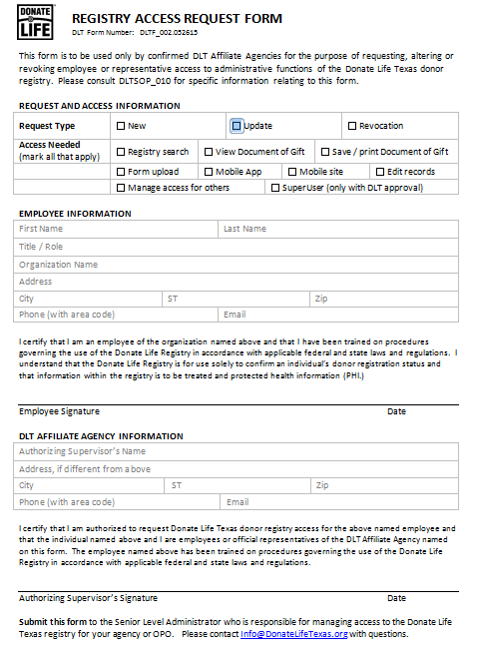
Access to use the DLT Scan App
The DLT Scan App can ONLY be downloaded and used by a person with DLT Registry Admin Access for the DLT Mobile App.
If you don’t have DLT Registry Admin Access, please complete a DLT Registry Admin Access Form and submit it to the person at your organization who is responsible for setting up systems access.
The following pages detail how to load and use the DLT Scan App on Android and Apple devices. The DLT Scan App is not currently available for the Windows operating system.

Slide 7
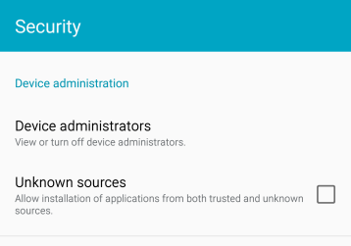
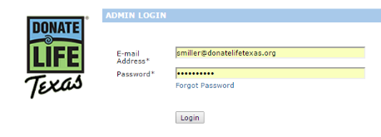
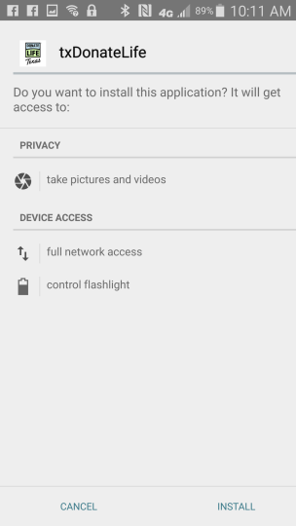
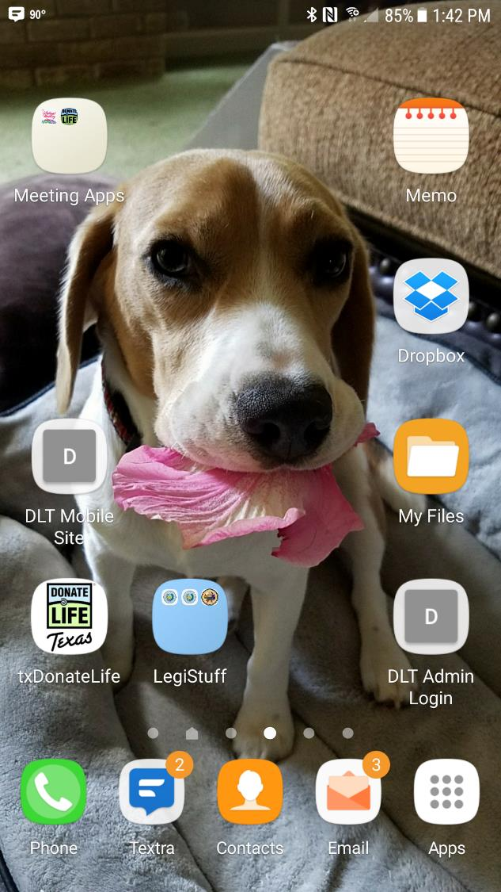
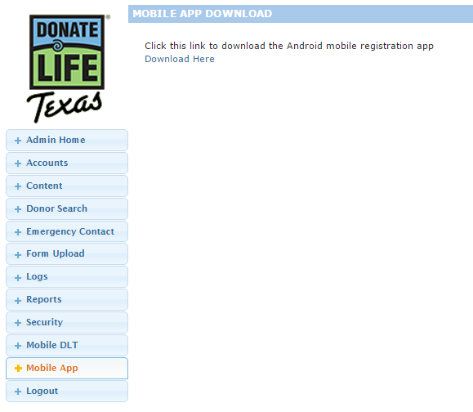
DLT Scan App Installation Instructions for Android Devices
To install the DLT Scan App on your Android Device, complete the following steps using the device (not on your desktop.)
On the device, open the Settings – General menu and open the Security page. Click to allow installation of applications from unknown sources. (You can turn this back off once the DLT App has been installed.)
Open your internet browser and navigate to the DLT Admin Access site: https://register.donatelifetexas.org/admin/
Log in using your DLT Admin username and password.
Select Mobile App from the left menu
Click Download Here
After the App has downloaded, click Install
Find the new txDonateLife app icon on your device screen. Reposition as desired.
1
2
3
5
7
4
6

Slide 8
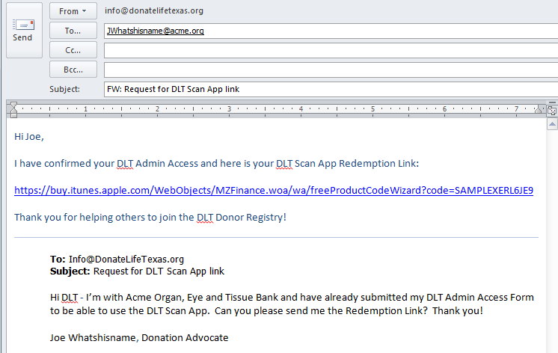
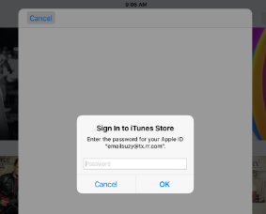
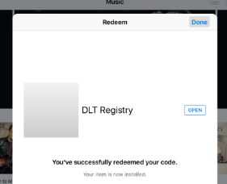
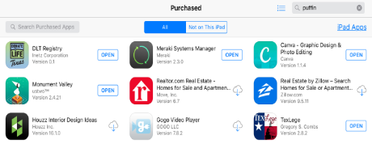
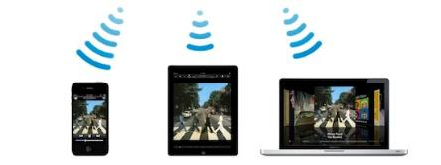
DLT Scan App Installation Instructions for Apple Devices
To install the DLT Scan App on your Apple Device, complete the following steps:
Once your DLT Admin Access is set up, request an Apple DLT Scan App link from DLT by sending an email to: Info@DonateLifeTexas.org
The reply email from DLT will have a unique, coded Redemption Link. This link is only good for a single use. Do not attempt to re-use or share the link – it won’t work
On the device you wish to install the Apple DLT Scan App, open the email and click the coded link.
You will be prompted to sign in to the iTunes Store using your iTunes account log in.
Click the “Open” button on the next screen with the message that you’ve successfully redeemed the code. The App will load automatically to the device.
The App can also be loaded onto any Apple device connected to your iTunes account through the App Store:
Example: if you have both an iPhone and an iPad on your iTunes account, you can load the DLT Scan App to both devices from the Purchased section of the App Store.
2 & 3
1
4
5
6
NOTE: If you have downloaded the App but cannot find it on your device, check the Purchased section of your App Store.

Slide 9
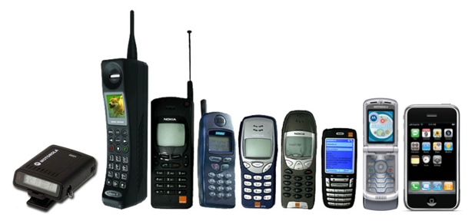
Reinstalling the DLT App On Your New Phone
Fortunately, phones evolve over time.
Changing phones will mean needing to re-install the DLT App.
Here’s how:
Old Apple phone to new Apple phone:
Open your App Store App and click the Purchased Apps tab
Find the DLT App and tap to reinstall it on your device
The apps usually appear in alphabetical order and the DLT App sometimes shows up as “TxDonate”
This process will work to install the DLT App on any Apple device connected to your iTunes account
Old Android phone to new Android phone:
Follow the original Android installation instructions, found here: www.donatelifetexas.org/scanapp
Switching from Apple to Android or from Android to Apple:
Follow the original installation instructions for your new platform, found here: www.donatelifetexas.org/scanapp

Slide 10
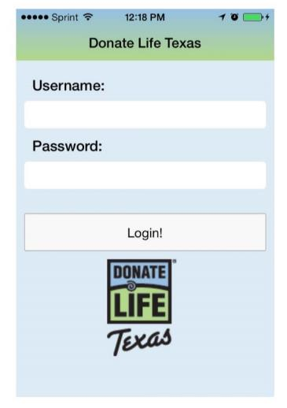
Get the Signal
Apple or Android, the App requires a strong, consistent signal to work properly. A weak signal or one with fluctuating strength can cause problems when trying to submit the encrypted license information to the registry.
Please take note of the signal strength where you are when using the device. If the cell signal isn’t strong or consistent, you may want to connect to WiFi instead.
Here are a few things to be aware of:
Buildings made of concrete (like hospitals) and below-ground areas (like basements) can weaken signal strength
Events or gatherings with lots of people who may also be using mobile devices (like concerts or sporting events) can cause signal strength to fluctuate

Slide 11
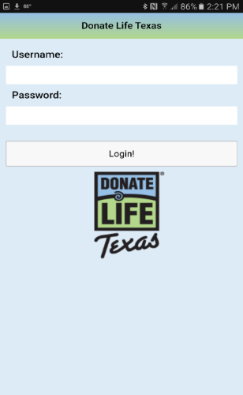
Using the DLT Scan App
The Android and Apple versions of the DLT Scan App work very similarly. These instructions provide the basic operating instructions, though actual device usage may vary slightly.
Make donor registration as easy as Scan. Click. DONE!
Open the DLT Scan App on your mobile device
Input your Username and Password to login
Usernames for the App are now abbreviated to the pre@ part of your email address, like this:
Email address: JoeWhatshisname@blahblah.org
New username: JoeWhatshisname
Note: the full email address is still required for logging into the DLT Admin Site.
JoeWhatshisname
***********
See Password Reset Info on Page #14

Slide 12
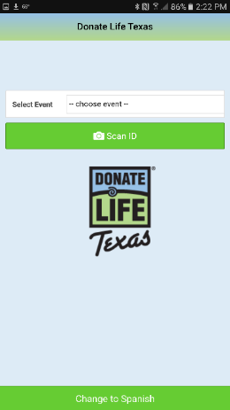
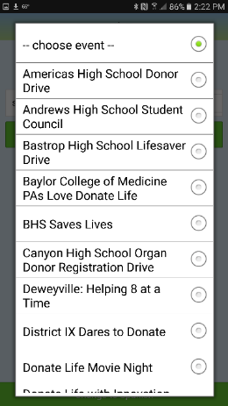
Once logged in, you’ll see an option that will allow you to attribute registrations to a specific event.
The events on the list are those with a corresponding online DLT Campaign Page, created using the Campaign Creator tool on the DLT website.
Not all events you attend will be listed. That’s OK, you can skip this step.
Select Choose Event to open the menu of options
Tap the dot next to the campaign of choice
Campaigns are listed in alphabetical order
Once you have selected an event, all registrations scanned after the selection will be attributed to that event until:
You select a different event OR
You log out
If the event you are working does not have an associated campaign, you can skip this step by tapping “Scan ID”
If you opened the list but don’t wish to choose an event, tap the dot beside - choose event – at the top of the list.

Slide 13
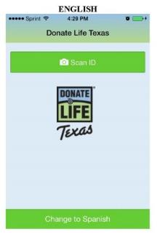
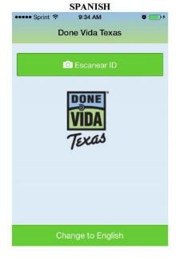
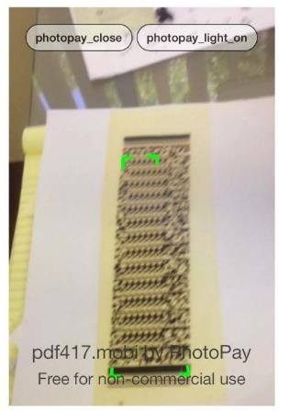
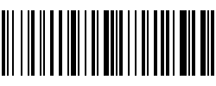
Toggle to use the applicant’s desired language – English or Spanish
Click “Scan ID” button
This will open the device’s camera
Align the card’s Digital Bar Code up with the on-screen scanning frame (seen below as green brackets)
Hold the phone so the bar code fills the majority of the screen
When the image is in focus, the App will automatically read the code.
DO NOT press the Photo button on your phone or take a picture.
Be sure to use the Digital Bar Code, not the old fashioned one.

Slide 14
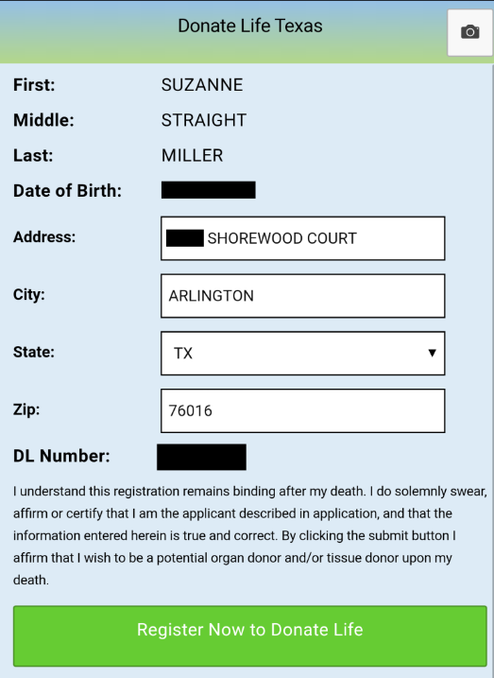
The App will populate the registration form with the card-holder’s information from the bar code.
Ask the registrant to review the information and make any changes needed
Changes made here will NOT update the card or the DPS system.
Ask the registrant to consent to organ, eye and tissue donation by clicking the Register Now to Donate Life button.
If the registrant wishes to make specific selections about types of donation, they will need to complete a paper or online registration instead.
Do not click the Register Now button multiple times unless prompted to do so. Multiple clicks can slow the system down and can cause the App to freeze.

Slide 15
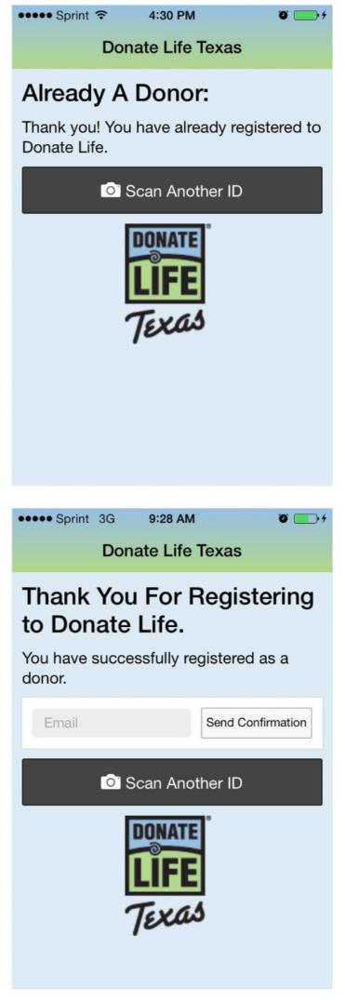
If the person is already registered, they will receive an on-screen thank you message.
If the person is not registered already, they will:
Receive an on-screen thank you message
Have the option to enter their email address so they can send themselves a confirmation by email.
Click the Scan Another ID button to register the next person to Donate Life!
Be sure to close the DLT Scan App when you are finished with it.

Slide 16
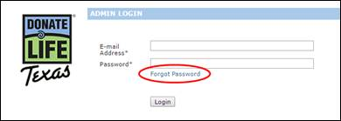
Resetting App Passwords
It happens. We all forget our passwords. Fortunately, with a few steps, you can reset it yourself in just a few minutes. Please read the instructions carefully because the reset process is not done in the App!
The App will lock you out after 3 failed login attempts. If you cannot remember your password, stop after two attempts and use the following steps to reset your password.
Use the internet to visit the DLT Admin Site here: https://register.donatelifetexas.org/admin/login
Click the “Forgot Password” link
Enter your email address
Enter your last name
Click Send
You will then receive an email from the DLT system with a new temporary, single-use password
Return to the Admin Site, log in with the temp password & set your new password
Close your internet app or browser
Then, open the DLT Scan App, log in and scan away

Slide 17
DLT Scan App – Use it Wisely
Remember, App usage is tracked using your login. Don’t let others use yours!
Your access will be revoked if unauthorized or irresponsible app usage is discovered. Also, HIPAA laws apply to the use of this App. Shenanigans while using this App could make you subject to prosecution, so let’s not go there.

Slide 18
Give It A Try!
If you’d like to practice using the App, you can use the login info below to open the App in “Demonstration Mode.”
When using Demo Mode, please note that:
No changes will be made to the DLT database
If you scan the license of a person who is already registered, you will not see the “Already Registered” message
DEMO MODE LOGIN:
Username: test@inetz.com
Password: testapp

Slide 19
Questions?

